Slide 1

LAKESMART: The Evolution of a Model Lake Protection Program

Slide 2
Maine Lakes
We Advocate for science-based watershed policy at the state legislature and inform the public about lake issues
Our LakeSmart Homeowner Education Program provides site-specific, individualized plans to prevent lake degradation
Annual Maine Lakes Conference is a one-day forum for lake stewards to network and learn the latest lake science and programs from experts and each other
You can sign up for Legislative Alerts on our website
www.lakes.me

Slide 3
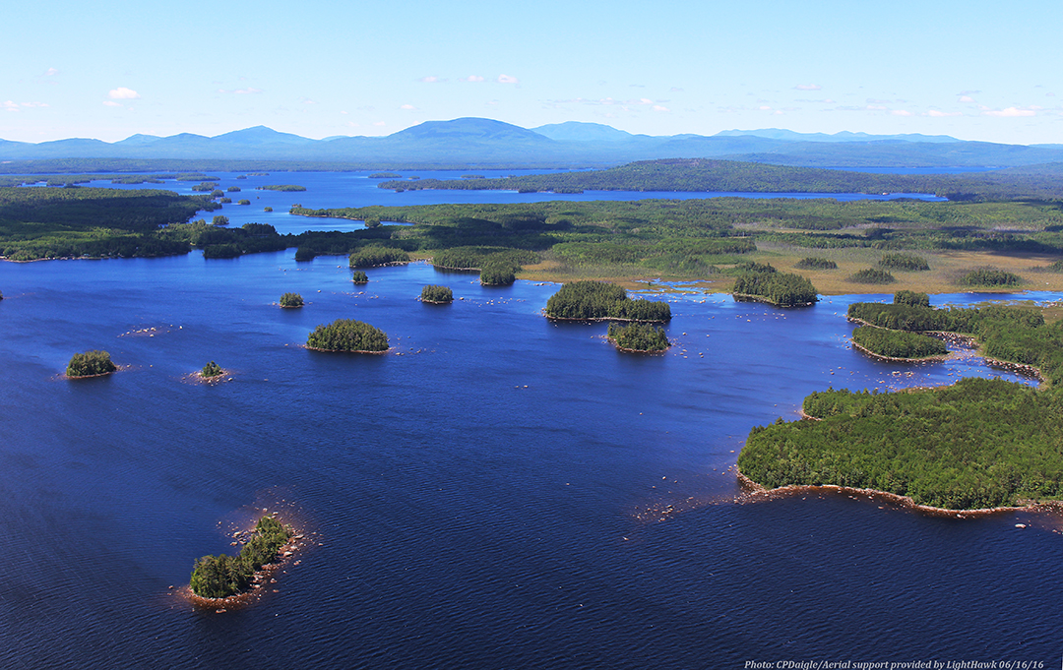
Maine has 6,000 Lakes
2,500 are Great Ponds

Slide 4

The great ponds belong to the people of Maine
In 1647 in the Massachusetts Bay Colony, lakes of a significant size were named great ponds and protected for public benefit.
When Maine became a state it retained the provisions of the Great Ponds Act.
Today, Maine’s great ponds generate:
$ 5 Billion in annual spending,
52,000 Jobs,
650,000 of us use them each year,
400,000 get drinking water from them.
Notes:
It is interesting to note that the commons, any commons whether lakes or village greens, can almost be defined by lack of public funds for their preservation. Our little victgory in the legislature last year was quite a step in commons protection, then.

Slide 5
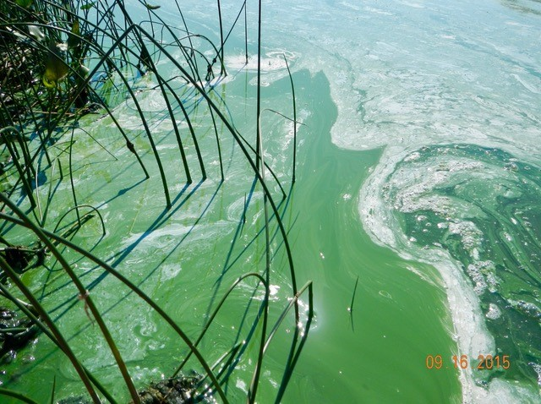
What’s the health status of these lakes?
Most are sparkling invitations to recreation, renewal and joy
But 22%of Maine’s great ponds evince measurable declines:
53 bloom, and
490 are “at risk from development” (MEDEP)
543 are therefore impacted by human activity
An Algal Bloom on Georges Pond in Franklin, ME
Notes:
This despite hundreds of $millions of Clean Water Act remediation projects, education and enforcement by state government, and the best efforts of hundreds of NGO’s
“at risk from development” is one of MEDEP’s classification of lakes, established at the time the Erosion and Sedimentation Control Law was enacted.
NPS High Priority Watersheds is another, smaller category, but highly significant because of money. Priority watersheds includes pristine lakes, water sources and threatened lakes; these are the waterbodies that can get Clean Water Act funds.

Slide 6
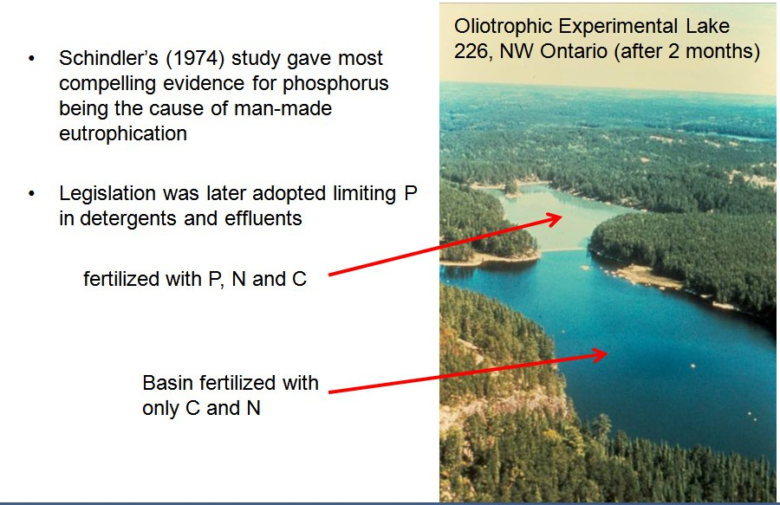
We have known what causes water quality degradation for forty five years
Notes:
This info is taken directly from the website of the Experimental Lakes Area, Ontario, Canada

Slide 7
We have also long known the solution: use Best Management Practices (BMP’s) to block the Nonpoint Source Pollution (NPS) that loads phosphorus into lakes
  Infiltrate stormwater runoff
  Stabilize the land’s surface
  Divert runoff to places where it will sink in
Notes:
The Best Management “fixes” are universally accepted stormwater management techniques that capture stormwater where it lands and infiltrate it into the ground. In Maine, Maine Department of Environmental Protection and the Portland Water District have published these practices in illustrated “Homeowner Instruction Sheets. LakeSmart uses these homeowner guides to teach lakefront homeowners how to prevent stormwater phosphorus loading.

Slide 8
Now, the forcing impacts of climate change increasingly threaten all surface waters. All surface waters. The stakes are high and getting higher.
Northern New England has 71 percent more intense storms today than it did 35 years ago. This rise is expected to not only continue but increase (CCI, UMO)
Development increases phosphorus loading 8 to 10 times above original conditions (MEDEP)
Maine needs, desires, and will have more development
The in-lake growing season is 3-4 weeks longer now than in 1850 due to shorter periods of winter ice cover
Summer temperatures are warmer
Notes:
No lake should be without active protection whether or not the damage is yet visible, it’s happening.
The Climate Change Institute info is key. Emphasize.
People like Kacey Weber in Piscataquis can’t convince her constituents how close the danger is because NPS is so insidious, invidious and sneaky

Slide 9
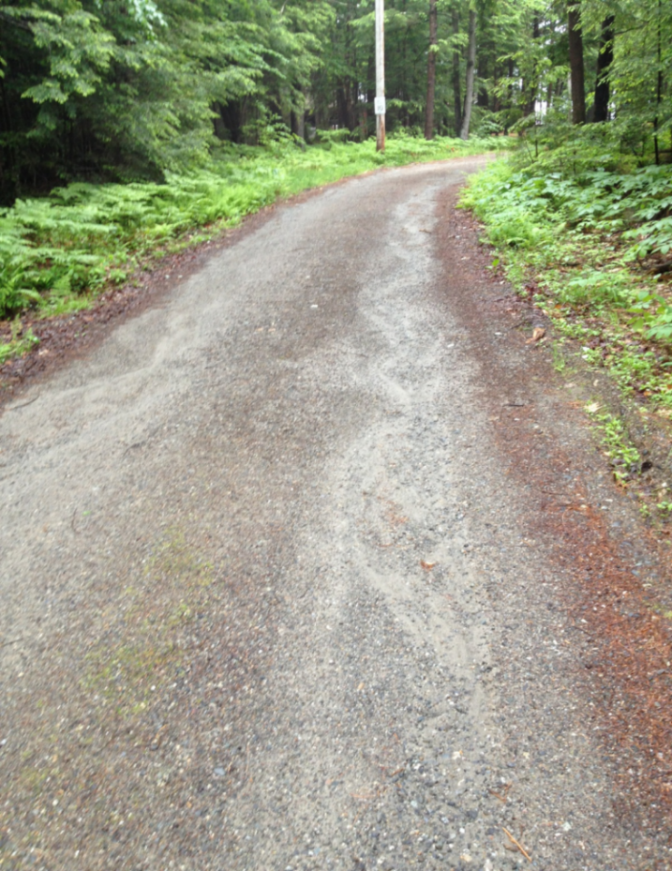
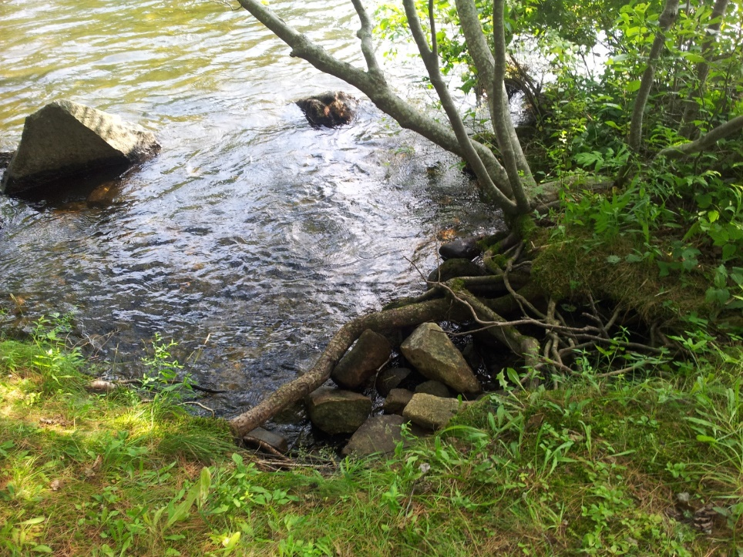
If we understand the problem and know the solution, why haven’t we made more progress in 45 years?
1) NPS is often so deceptively insignificant looking … nobody even sees it even though it’s ubiquitous
2) NPS threat isn’t recognized or understood by the public
Notes:
Despite being the leading cause of lake declines, the phosphorus loading from nonpoint source pollution is most often an unintended consequence of ignorance or well-intentioned acts by people who would never, ever knowingly harm their beloved lake.

Slide 10
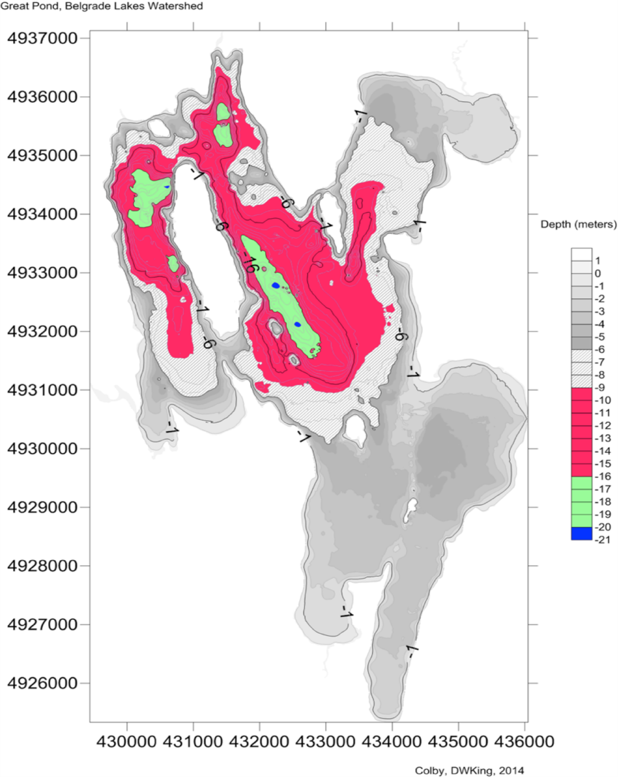
ANOTHER REASON: NPS IS A STEALTHY FOE
This map shows the expansion of anoxia in Great Pond, Belgrade, where Secchi disk readings are still mesotrophic.
It illustrates how NPS damage can spread unnoticed until it approaches – or crosses - the tipping point wherein the clarity of the lake can change seemingly overnight
Map courtesy of D. Whitney King, Miselis Professor of Chemistry, Colby College, Waterville, ME
4
Notes:
The anoxia in this lake has grown by 35 times in extent since first mapped. This portends real trouble, but lake Secchi depth readings are still in the medium range for Maine lakes - - around 5.5 m, and not by themselves raising concerns. Unless lake activists know enough and take the trouble to measure dissolved oxygen at depth, they would not know that the entire red area is pumping phosphorus from the sediments into the water column from July through lake turnover in October and threatening to raise the total phosphorus content of the lake to the tipping point of 13 or 15 ppb where the water will turn opaque, green, smelly and kill fish and recreation.
WAKE UP, EVERYBODY

Slide 11
THEN TOO … behavior is notoriously hard to change. A well-known experiment shows just how resistant to change most of us are:
Scott Geller, 1981
Results from follow up visits
Intensive Education on residential energy consumption
40 voluntary participants
3 Hour Multi Media Presentation
Tested before and after Post test showed that participants
  Showed greater awareness
  Knew what actions to take
  Were willing to implement changes suggested in the workshop
Behavior did not change
1 person lowered thermostat
2 put insulating blankets around their hot water heaters.
  This was before attending workshop
The only real difference?
  8 (versus 2 in the control group) installed efficient shower heads.
  Every participant had been given a free shower head for attending
Notes:
Tried to lose weight lately? composted your kitchen veggies through January, February and March?
Started a gym routine?

Slide 12
Similar proofs go on … and on
Six day workshop
10 week water use study
Focus: environmental issues
High school students
2 month follow up showed
No one engaged in pro environment activity
Jordan, Hungerford, Tomera, 1987
Households volunteered to participate
Recorded their daily household water use over this time
Received state of the art handbook
Replete with detailed directions
No effect on water use
Geller, Erickson, Buttram, 1983
Notes:
Be sure to indicate that there is a lot more proof for this in CBSM on which Hoppe and Smith based their program.

Slide 13

LakeSmart, a DEP Solution for Nonpoint Source Pollution
LakeSmart was created by Kathy Hoppe and Christine Smith of the Maine Department of Environmental Protection in 2003 to spur conservation behavior.
It was a recognition program that conferred the coveted LakeSmart Award on lakefront homeowners for maintaining their properties in lake-protective fashion. Award signs, posted at waterfront and driveway, pointed out good practice and good stewards.
It employed technically trained experts to visit homeowners who signed up through their lake associations. Limited funds kept the program from taking in all lake associations that wanted to participate. Homeowner instruction was limited
Notes:
LakeSmart is voluntary, non-regulatory and free, It combines site assessment and Best Management Practice (BMP) suggestions with homeowner recognition. Assessments cover four areas: Driveways and Parking; Structures and Septic Systems; Yards, Recreation Areas and Pathways; Buffers and Water Access. A score of 70% or more in all sections rewards homeowners with the coveted LakeSmart Award, distinctive signs for posting at shorefront and driveway entrances to highlight best practices and promote diffusion. From 2003 to 2011, MEDEP employed Soil and Water Conservation Districts for site assessments and engaged 453 homeowners.

Slide 14
How Maine Lakes Changed LakeSmart
When the LePage Administration defunded LakeSmart, Maine Lakes took it over – 2012-2013.
We made two major changes to the program:
  We dedicated strenuous efforts to training and supporting lake association volunteers in their field work, adding volunteer management to the task.
  From the outset, we saw the LakeSmart encounter as a teaching moment and used the opportunity for experiential demonstration of NPS pollution and the practices that block it.
Notes:
The Maine Lakes Society (MLS) adopted LakeSmart in 2012, restructured the program, and has since interacted with more than 1,000 homeowners on 73 lakes. MLS provides all materials and certifies awards. To increase adoption of Best Management Practices (BMP’s) and minimize expense, MLS trains lake association volunteers to promote and implement LakeSmart, although technically trained staff are employed by three of the participating lake groups. Trainees conduct surveys, summarize findings and walk properties with homeowners to identify NPS problems, recommend BMP’s, and encourage action-oriented goal-setting. Other changes to the program under Maine Lakes Society include: post-visit thank you letters with site-specific recommendations and BMP instructions; online surveys and training, Commendation Certificates for non-awardees; a loon conservation incentive; and geographically distributed HUBs to provide on-site technical support to volunteers.

Slide 15
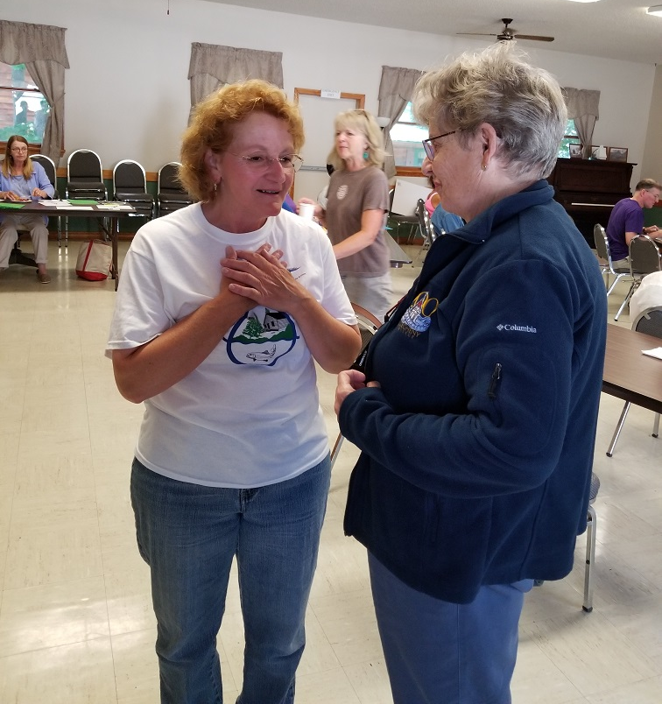
KEY #1 to LakeSmart’s power to change behavior:
Think of the last book you read, movie you saw or restaurant you tried.
Did a friend recommend it?
If so, you have experienced the power of the Referent Effect
People are much more inclined to listen to family, friends, co workers and neighbors than to removed sources such as media, advertising, or outside experts
Notes:
Redwood River Clean Water Project sought to improve water quality in a farming area with degraded lakes in the Midwest. (This is the only like LakeSmart example in DMM’s book CBSM. When I found it, I was cross he didn’t acknowledge LakeSmart wasn’t so far out, afterall.)
The large project area was divided into communities where people knew each other, went to the same Grange, etc.
BMP installation was encouraged by having a community leader adopt new practices and talk about advantages.
Knowledge of the improvements was spread through one on one conversations
People at large also heard about others using BMP’s through newsletters, websites, handouts, meetings
300 BMP’s were adopted resulting in, one hundred fifty eight tons of phosphorus and soil reduced per year

Slide 16
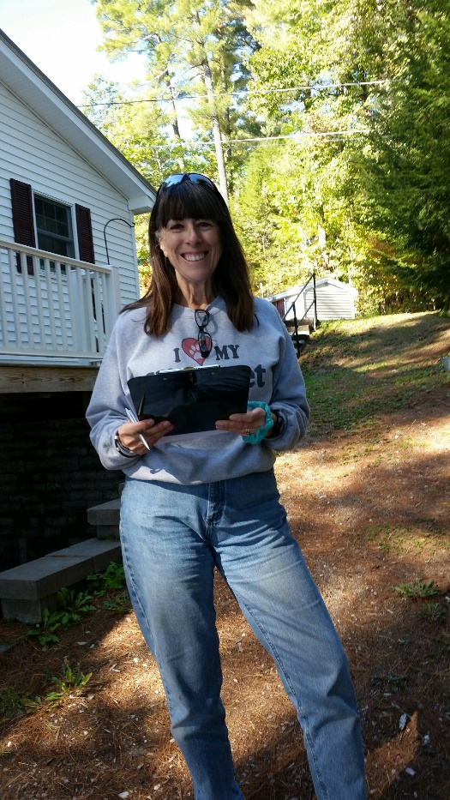
Knowledge information brochures experts do not, by themselves, change behavior.
But lake association volunteers have a passkey to the clubhouse, an “in” that validates
Who the Messenger is makes all the difference… In this case, it’s Diantha Grant of Sabbathday Lake Association in New Glouster
Community
Not just a neighbors, member of an affinity group
Common interests
Not a stranger
Trust
Even better if a leader
Notes:
Who could say no to this lady?

Slide 17
KEY #2 The experiential learning that takes place as the homeowner walks the property with the Evaluator, identifies NPS sites and learns how to plug them to protect the water.
Homeowner David Gay of Belgrade Lakes, Maine, on discovering the ways his home was impacting the lake he and his wife Susan loved so much,
“We were looking, but we did not see.”
Notes:
It is one thing to learn about stormwater runoff in lake watersheds and another thing entirely to discover that one’s path to the lake has been polluting it for 30 years. The discovery is almost visceral. Real. Unforgettable. Not a fact, a problem to take care of.

Slide 18
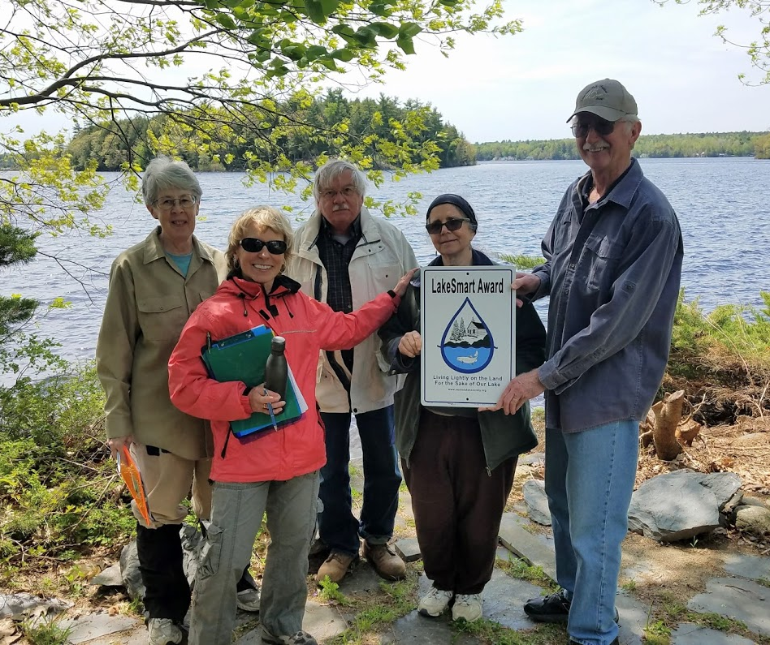
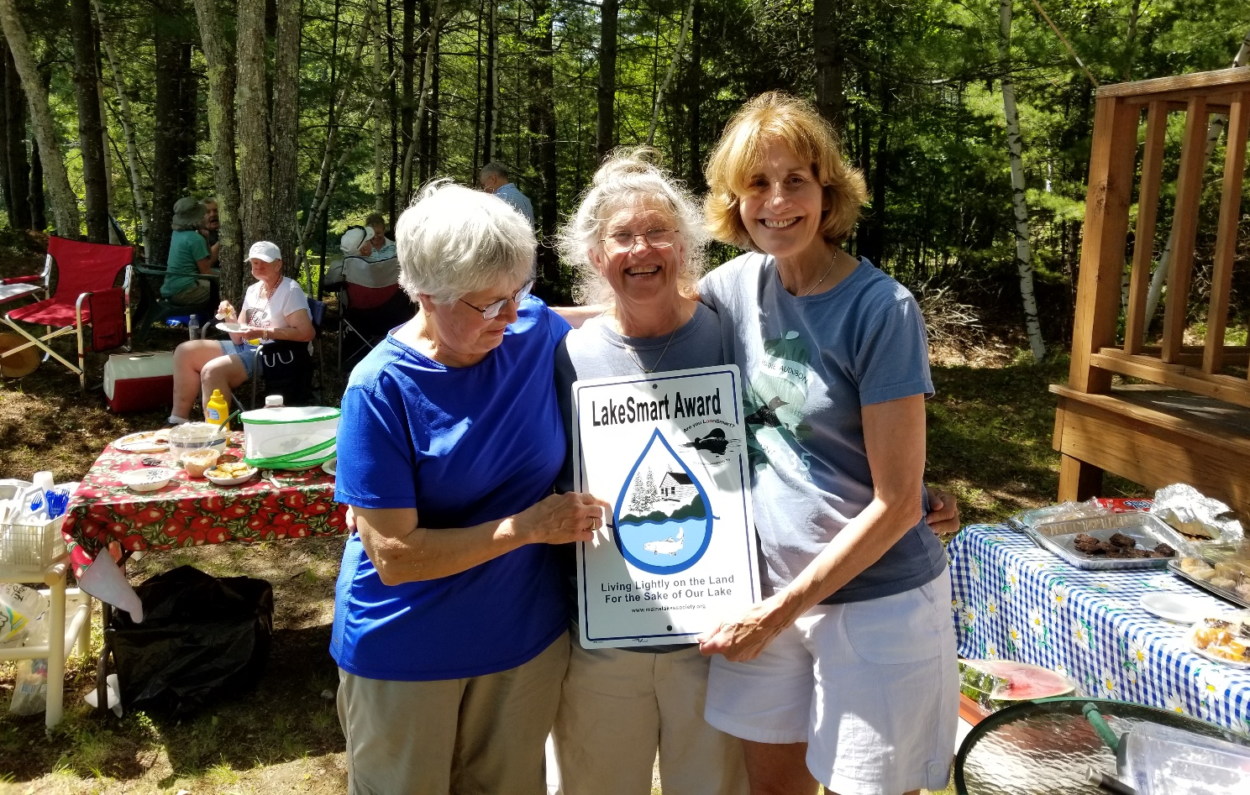
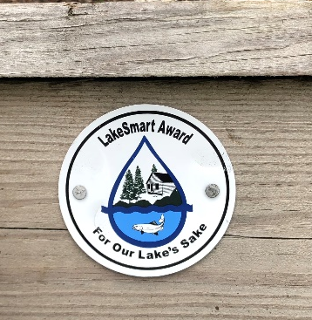
The Power of Community:
Notes:
Modelling stewardship within the group demonstrates and diffuses the desired behavior across the whole community

Slide 19
HOW IT WORKS: THE LAKESMART VISIT
Survey Divides the Property into 4 Parts
and Scores each Section Separately
Driveway and Parking
Structures and Septic System
Yard, Recreation Areas and Pathways
Buffer and Water Access
70 % in each section =
Notes:
We ask is there runoff? Where does it end up?
What’s the condition of the shore? The buffer? The leach fiueld?
Each question has numerically graded answers (2 to 5) to aid accuracy and consistency of evaluations
We never go where we are not invited

Slide 20
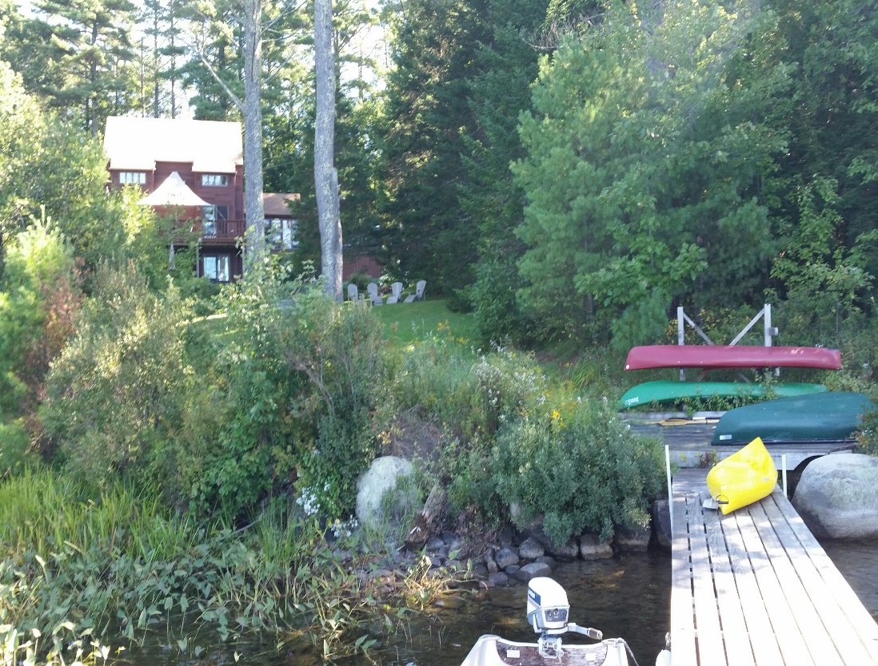
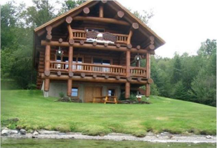
LakeSmart’s Long Term Goal:
Establish a Norm of lake Friendly Living across an entire Community
Person by Person and Shore by Shore
We reward this
Not This

Slide 21
LakeSmart’s Remedy Replicates Nature’s Filter
Keep all stormwater out of the lake
  Capture stormwater on land
  Soak stormwater into the ground
Stabilize the land
  Cover bare soil
  Plant hardy vegetation
Divert flows to natural or manmade “sinks”
The narrow band of land along the lakeshore is the last chance we have to stop stormwater runoff

Slide 22
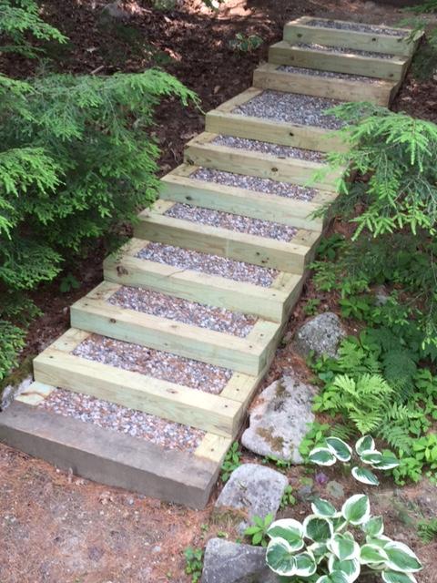
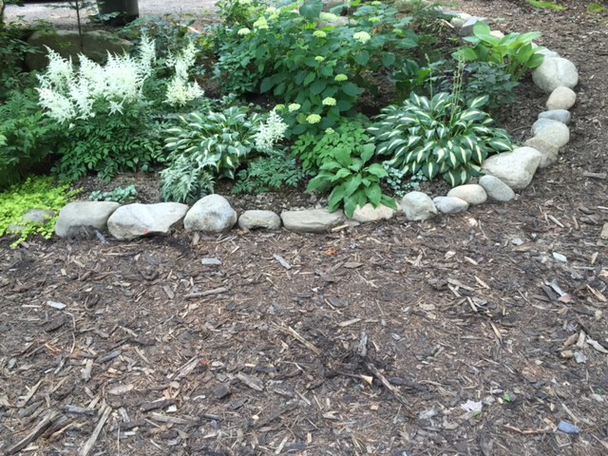
The BMP’s include Rain Gardens, Erosion Control Mix and Erosion Control Steps.
Illustrated directions are sent with Homeowner “Thank you’s” for participating

Slide 23
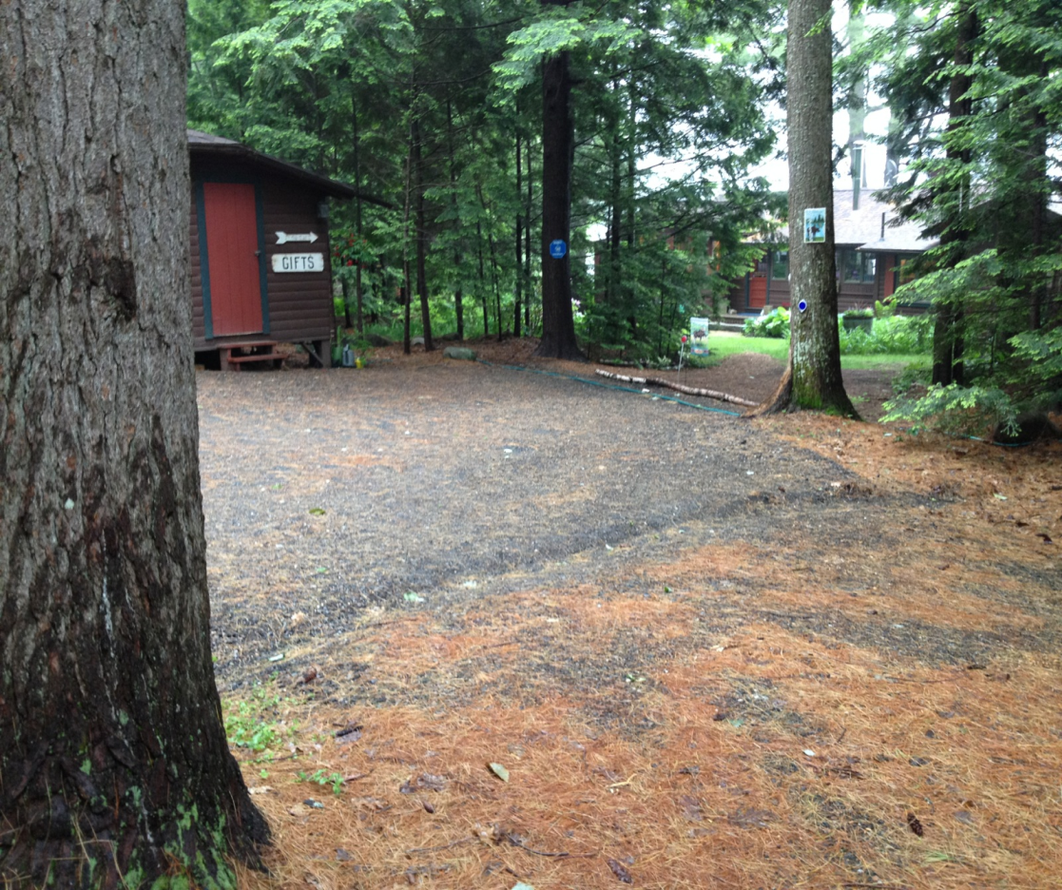
Diverting Stormwater to areas where it will soak into the ground and become groundwater is another common sense solution
Technical Terms for some simple practices:
Trench or Swale and a Water Bar shunt water to BMP “sinks,” in this case, the green of vegetation.

Slide 24
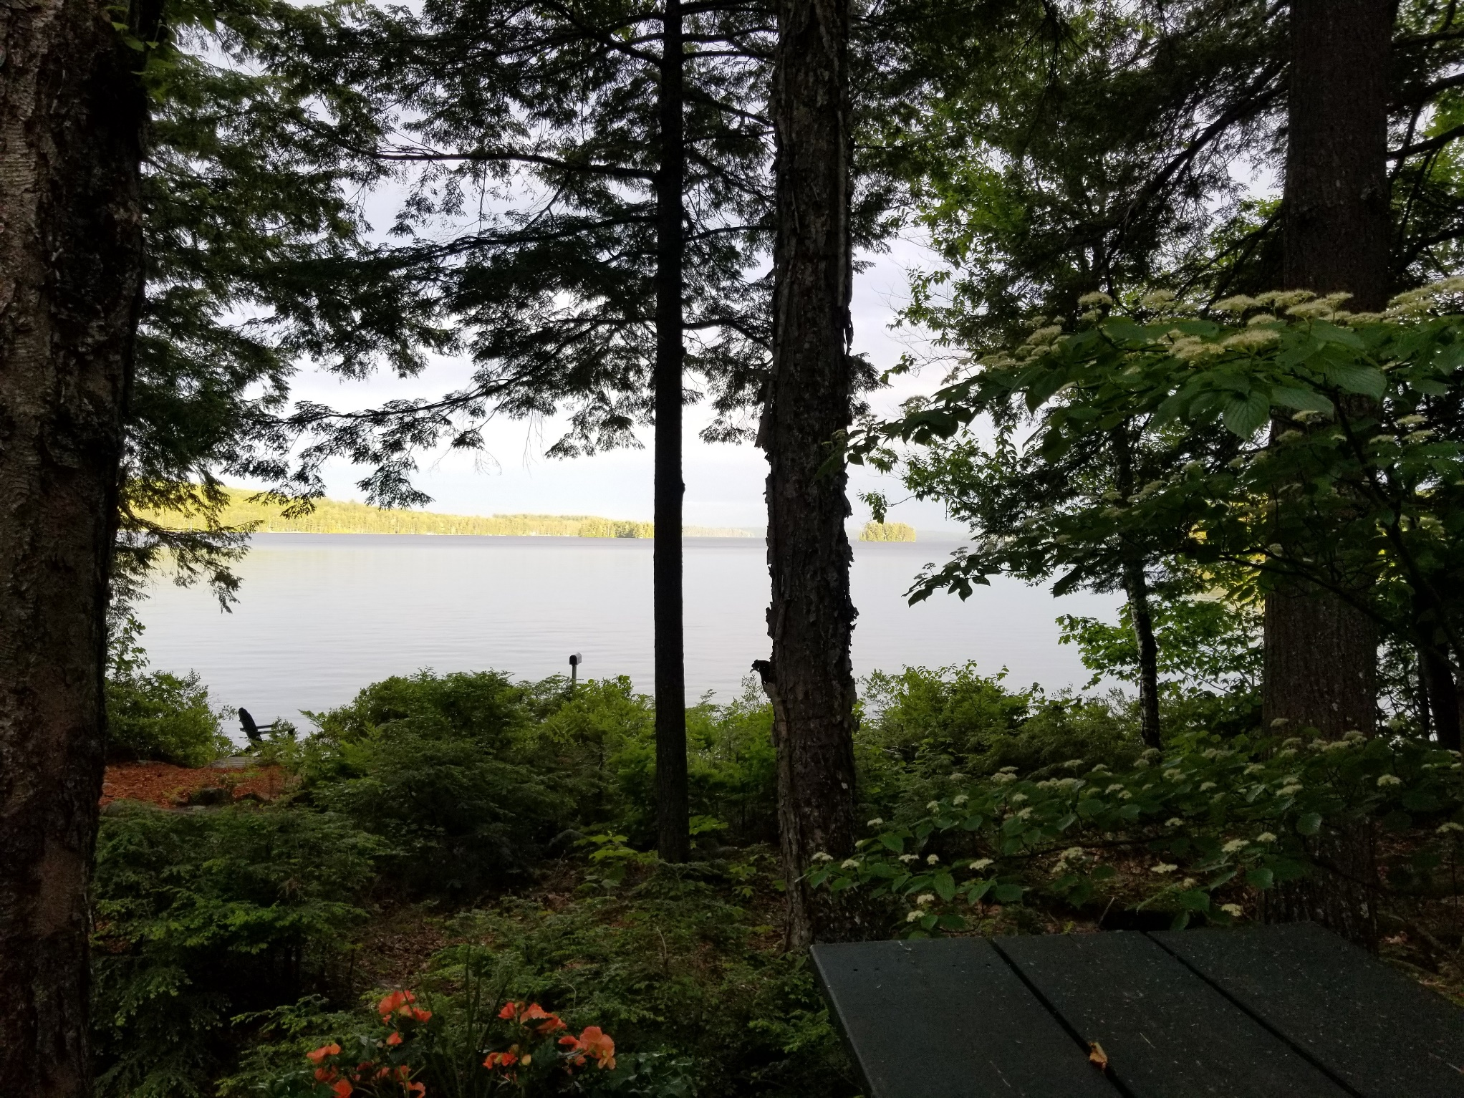
5 Recommended Layers of Protection between sky and soil. Award properties must have 3 sturdy layers.
Canopy
Mid-story
Shrubs
Duff
Ground cover

Slide 25
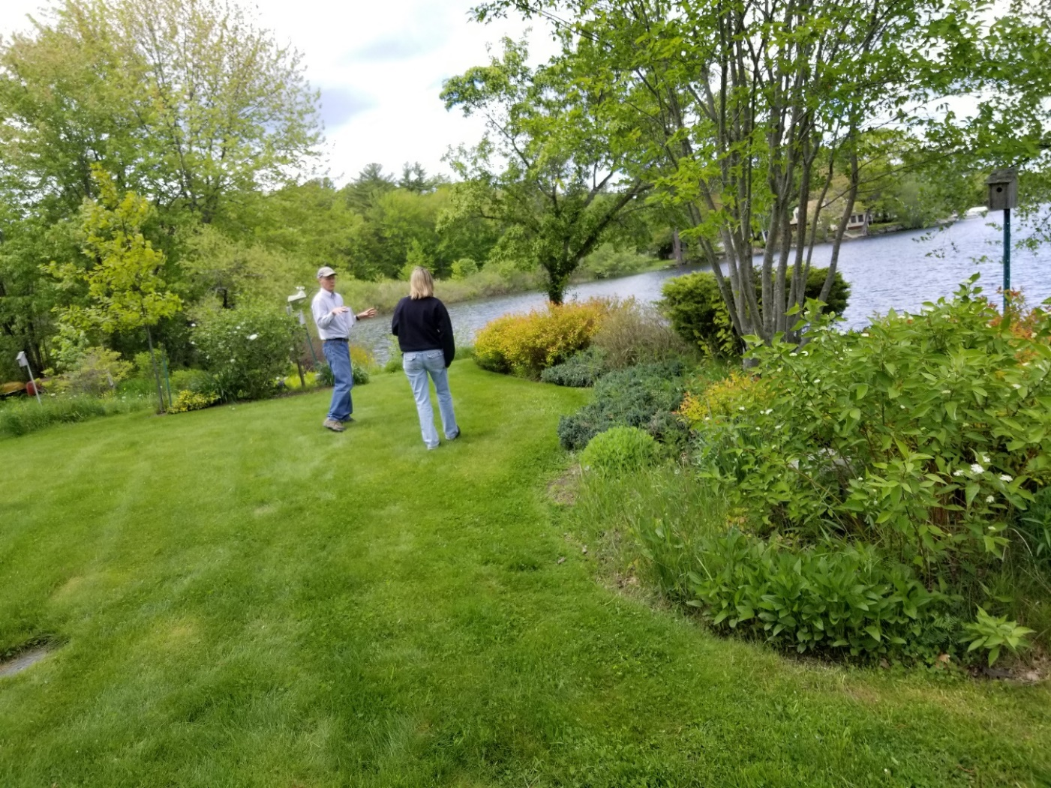
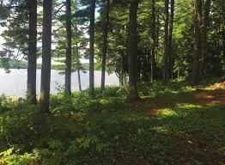
Landscaped or Natural, There Are Many LakeSmart Ways to Protect the Water

Slide 26
The LakeSmart Brand
Award Signs identify homes of good lake stewards
Award properties demonstrate lake-friendly behavior
Award signs spark curiosity. People ask, “What is that? How do I get one of those?”

Slide 27
Maine Lakes Society Provides all Materials
AND:
Presentations to Meetings of associations and/or their boards of directors
A full day of training followed by required on site practice session ay homes on the group’s home lake
Real time counsel, support, feedback and certification
Easy to use online tools for making LakeSmart surveys, learning to run LakeSmart, keeping records and accessing more learning resources
Two in-person networking opportunities each year

Slide 28
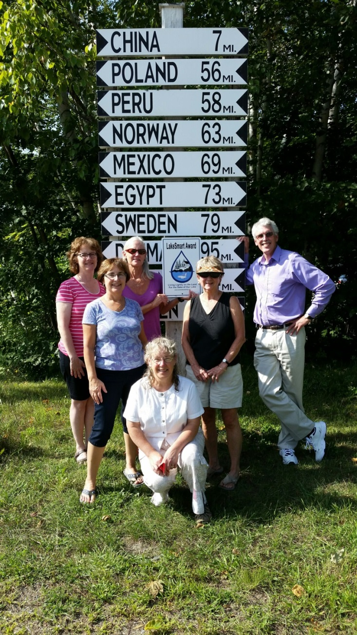
LakeSmart is a Team Effort
Lake Associations handle local outreach/publicity
Conduct evaluations, make recommendations to homeowners and thank them for stewardship
Keep records, report, and distribute Awards
Create a community norm for lake protection over time

Slide 29
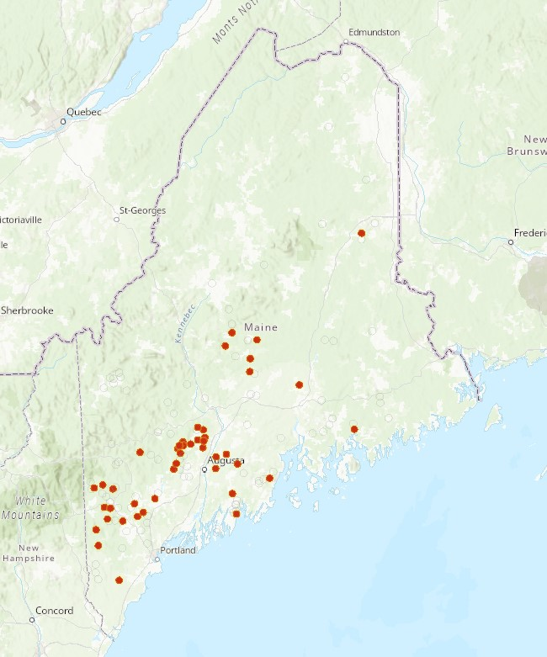
Where we are with LakeSmart today
65 groups host the program. More are lined up for 2020.
6 geographically distributed HUBs support local volunteers
Training is available in online videos and is provided in person across the state each summer
250+ lake-saving encounters with homeowners took place in 2019

Slide 30
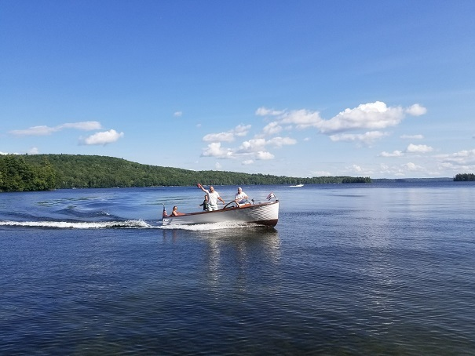


Preserving the Legacy We Leave to Others

