Slide 1
The Pierce House
The Farmington Home for Aged People
Darlene Mooar, Administrator

Slide 2
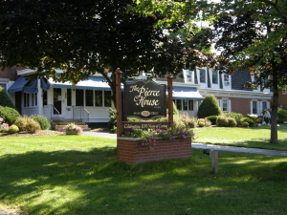
The Pierce House

Slide 3
History of Farmington, Maine
Abenaki/Wabanaki
Native Americans called it “The Great Intervale”
Incorporated 1794
Early inhabitants: Stephen Titcomb, Robert Gower, Judge Thomas Parker, Supply Belcher
1840 Farmington Agricultural Fair
Source: Coombs & Simpson, (n.d.).

Slide 4
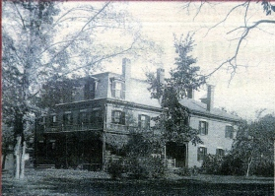
History of the House

Slide 5
History of the House
Robert Goodenow built the original house in 1835
Daniel William Austin purchased the house in 1885
Charles Harlow Pierce purchased the home in 1907

Slide 6
History of the House
Robert Goodenow built the original house in 1835
  Farmington attorney and US Congressman
Daniel William Austin purchased the house in 1885
  Farmington businessman, originally from New York
  Added the mansard roof
  Ancestor of local Austins, Morrills, Dingleys, and Kendalls
Charles Harlow Pierce purchased the home in 1907
  Farmington banker and tax collector
  Ancestor of local Tylers, Ibarguens, and Webbers
Source: Kaniuka, (2005).

Slide 7
Farmington Fire of 1886
Started by a spark from a narrow gauge train locomotive?
32 homes and 42 businesses were ruined
The Austin mansion survived!
Source: Coombs & Simpson, (n.d.).

Slide 8
History of the House: 1905
Incorporated by the state of Maine
The Farmington Home for Aged People
Bank balance $7
Source: Kaniuka, (2005).

Slide 9
History of the House: Original Trustees
The founders were: Julia Butler, Lydia P. Holley, Anna B. Austin, Henrietta W. Brown, J.P. Thwing, H.M. Thwing, Austin Reynolds, Luella Reynolds, Benjamin Goodwin, Nancy Goodwin, Susan E. Smith, Orrah Jennings, Charles H. Pierce, Ella C. Pierce, Harriet P. Keyes, S.C.B. Ramsdell, Belle Gillman, Anna Butterfield, H. Herbert Rice, Ida M. Rice, S. C. Belcher, Ella O. Belcher, John T. Linscott, Chester Greenwood, and Isabele W. Greenwood.
Source: Kaniuka, (2005).

Slide 10
History of the House:
Henrietta Whittier Brown
Founder and First President
Had a dressmaker shop in New Sharon
Made the first donation to the organization: $1.00
Source: Kaniuka, (2005).

Slide 11
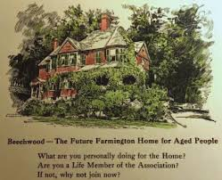
History of the House:
Belle Wright Gillman
First Vice President
Built Beechwood on Anson Street, later owned by the Etzels
Donated Beechwood to The Farmington Home
for Aged People for its first home,
but trustees declined due to location
Source: Kaniuka, (2005).

Slide 12
History of the House:
General Edmund Hayes
Graduate of the Farmington Normal School, Dartmouth College, and Massachusetts Institute of Technology
Engineer
Offered a $25,000 matching grant for start-up costs
Source: Kaniuka, (2005).

Slide 13
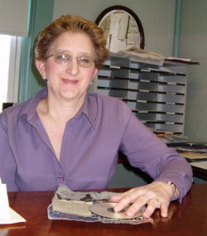
The Pierce House: Administrative Team
Darlene Mooar, Licensed Administrator
Pamela Hodge, Assistant Administrator
Carmen Burke, Resident Care Coordinator
Beverly Richards, BSN, RN, Registered Nurse Consultant

Slide 14
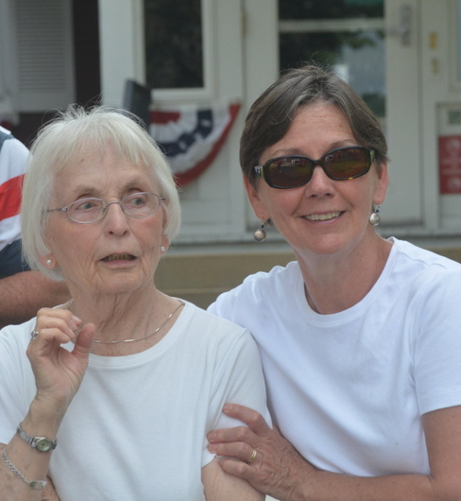
The Pierce House: Friends
The Friends of The Pierce House is a group of volunteers who provide social services to the residents that go beyond the required and expected care-giving responsibilities of the staff. The visits with the Friends also strengthen the personal connections between residents and the community.

Slide 15
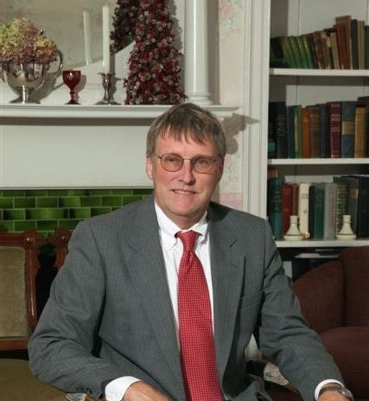
The Pierce House: Trustees
The Trustees are committed to providing a home-like facility with a caring atmosphere for older citizens who require assistance with the activities of daily living. The long-range goal of the Board of Trustees is to continue the legacy of the Founders, who, in 1905, recognized the need for this facility.
Today the Pierce House is a unique home for our elders: historic, vibrant, and welcoming.

Slide 16
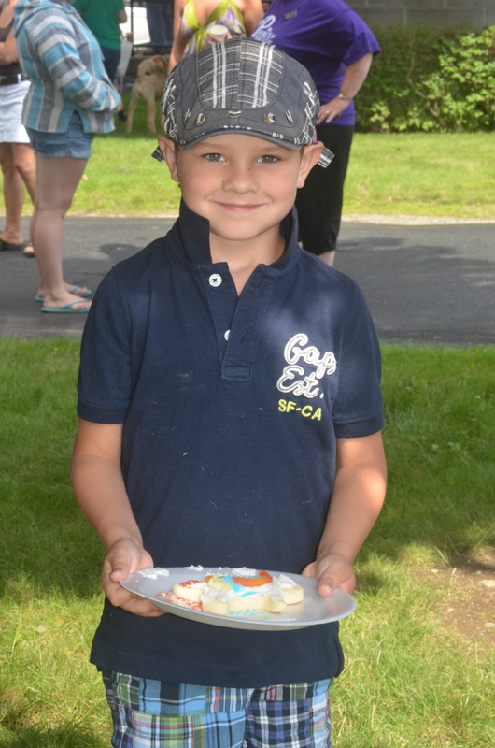
Events
Love Luncheon
4th of July: Parade, cookie-decorating, Centennial Band
Volunteer Appreciation Dinner
Grandparents Day
Christmas Holiday Open House
Festival of the Trees
Monthly teas
Residents’ birthdays

Slide 17
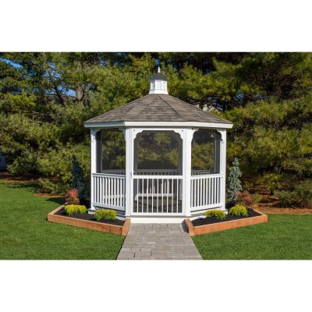
Donations
Despite changes in health care regulations, increased costs of health insurance for the full time employees, and soaring fuel costs, the Finance Committee has managed to keep the monthly rates below market costs.
Today, income comes through endowments, charitable donations, and rental fees. Recent bequests range from the amount of $20 to over $360,000.
Thanks to recent donations we built a beautiful gazebo for residents to enjoy.

Slide 18
Contact Us
Administrator: Darlene Mooar
The Pierce House
204 Main Street,
Farmington, ME 04938.
Phone: (207) 778-4745
Fax: (207) 778-5922
Web: www.ThePierceHouse.com

Slide 19

The Pierce House Online
Check out our web site!
www.ThePierceHouse.com

Slide 20
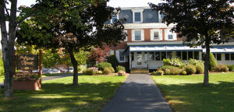
The Pierce House

Slide 21
Sources
Coombs, M.T. & Simpson, W. (n.d.). Farmington. http://farmington.mainememory.net/page/718/display.html
Kaniuka, M.J. (June 28, 2005). Special Supplement, Morning Sentinel.

